Slide 1
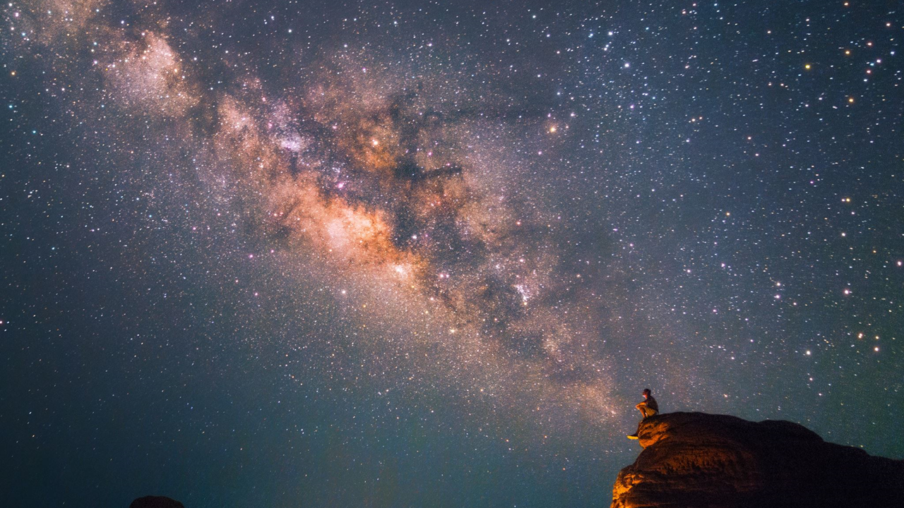
ASTROVISION

Slide 2


GUIDE
Dr. Pon Harshavardhanan
TEAM MEMBERS
PRANJAL ROY 19BAI10008
SHANZEH BATOOL 19BAI10017
KARAN JAIN 19BAI10095
SHALINI DAS 19BAI10139

Slide 3
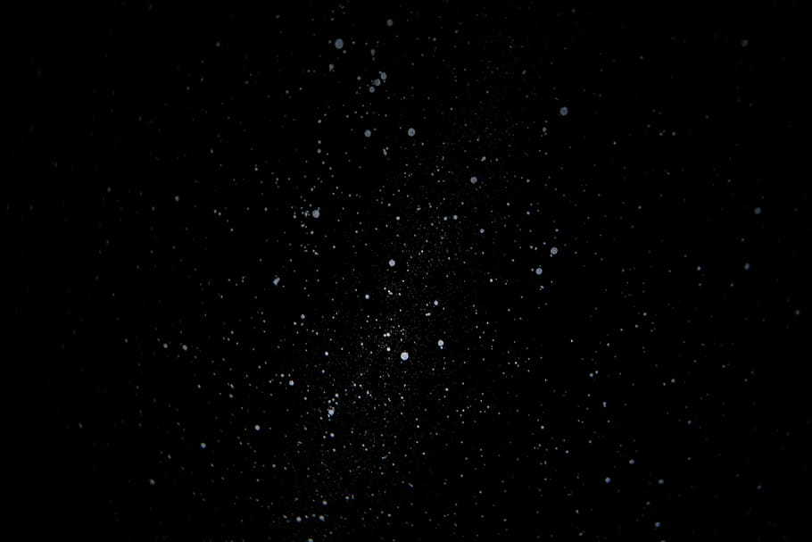

ZEROTH REVIEW

Slide 4

INTRODUCTION
OBJECTIVE
Calculating redshifts of distant galaxies using decision trees for regression.
Classification of different types of galaxies using feature extraction and applying decision trees and random forest algorithm for classification.

Slide 5
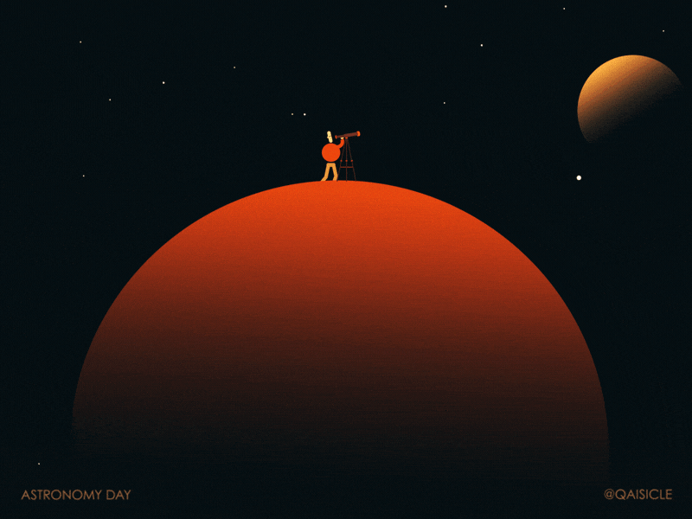
Why is classification so important?
Classification based purely on observational properties of stars and galaxies is an empirical result that can survive regardless of changes in the theoretical interpretations.
The amount of information we need to process if we treat each star or galaxy from a large survey as an individual is so overwhelming as to be nearly useless. Classification allows us to draw meaningful conclusions from data by abstracting it into categories.
Most importantly, classification can lead to a deeper physical understanding of the data.
Notes:
6 TO 10 20 TO 25 40 TO 41 YESS Then i will do 7 and 10? Ok wait wait

Slide 6


EXISTING
WORK
WITH LIMITATIONS

Slide 7
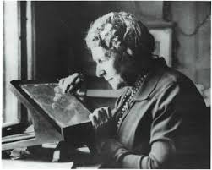
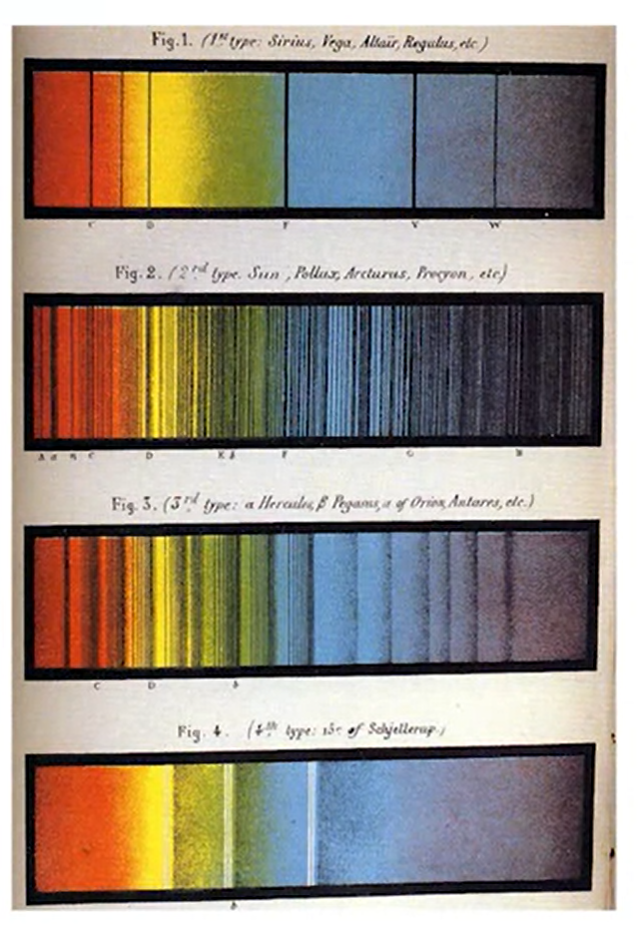
Annie Jump Cannon was an extremely productive classifier. Between 1911 and 1915, she classified 5,000 stars a month, resulting in an incredible set of over 200,000 stars that eventually formed the Henry Draper catalogue. Despite Annie Cannon's incredible effort, she wouldn't be able to keep up with today's data rates. In a world where the space telescope will absorb one billion stars, a quick back in the envelope tells us that it would take any of a 16,000 years to classify them by hand.
It's relatively straightforward for a person with a help of a computer to measure a red shift from a galaxy with an observed spectrum and hence work out how far away the galaxy is. But many galaxies have not been observed spectroscopically, we only have images. In addition, the sheer number of galaxies in the surveys makes this task impractical to do by hand.

Slide 8
The world of galaxy: Automated classification method
April 12-14 1989
One of the earliest automated galaxy classiﬁcation scheme according to their morphology can be traced back to the proceedings of the astronomy conference entitled: ‘Le Monde des Galaxies’.
Barchi et al. cite the importance of morphological classiﬁcation of galaxies to understand the large-scale structure of the Universe. They categorize decision trees to traditional approach contrasting the more advanced, deep learning technique. One may assume that the deep learning technique would yield more accurate predictions.
However decision trees tend to overfit the data and hence it is one of the limitations of this existing work.

Slide 9

PROPOSED
WORK
AND
METHODOLOGY

Slide 10
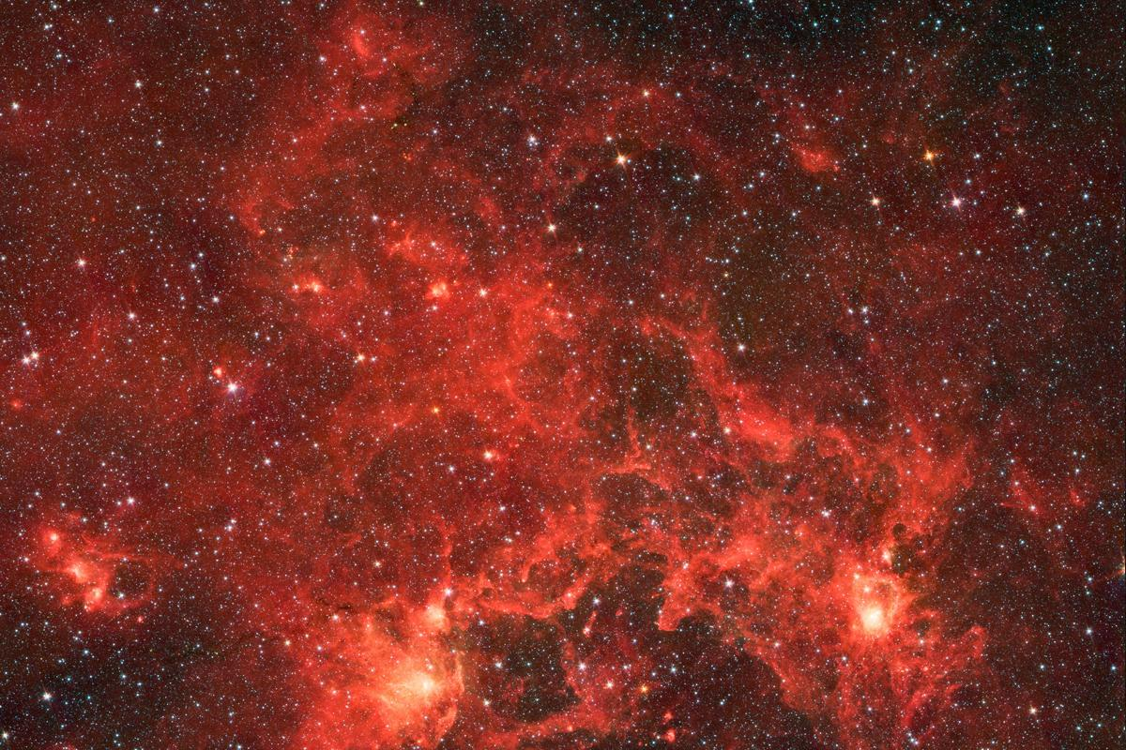
Calculating Redshifts

Slide 11
In the current standard cosmological model, the universe began nearly 14 billion years ago, in an explosive event commonly known as the Big Bang. Since then, the very fabric of space has been expanding, so that distant galaxies appear to be moving away from us at very fast speeds. The uniformity of this expansion means that there is a relationship between the distance to a galaxy, and the speed with which it appears to be receding from us. This recession speed leads to a shift in the frequency of photons, very similar to the audio doppler shift that can be heard when a car blaring its horn passes by. If a galaxy were moving toward us, its light would be shifted to higher frequencies, or blue-shifted. Because the universe is expanding away from us, distant galaxies appear to be red-shifted: their photons are shifted to lower frequencies.
In cosmology, the redshift is measured with the parameter , defined in terms of the observed wavelength and the emitted wavelength :

Slide 12
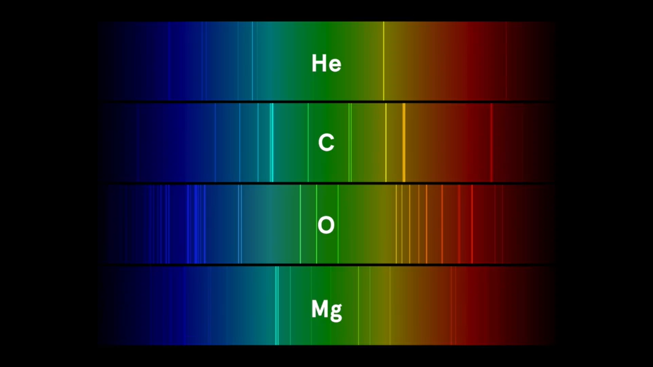

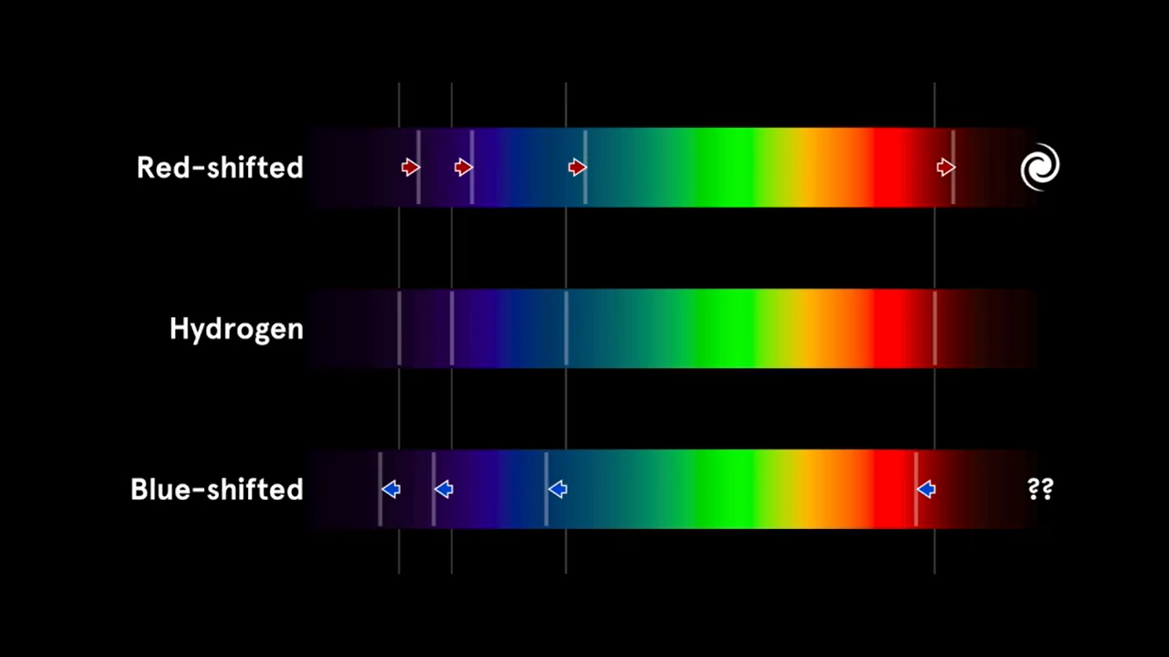
ELEMENTS WITH UNIQUE SIGNATURE OF WAVELENGTHS
SHIFTING OF WAVELENGTHS -
REDSHIFT & BLUESHIFT

Slide 13
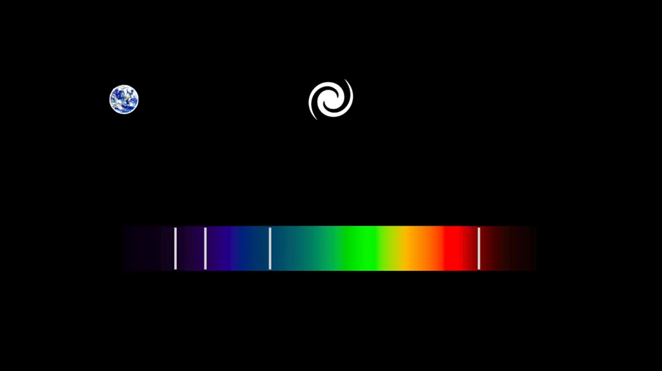
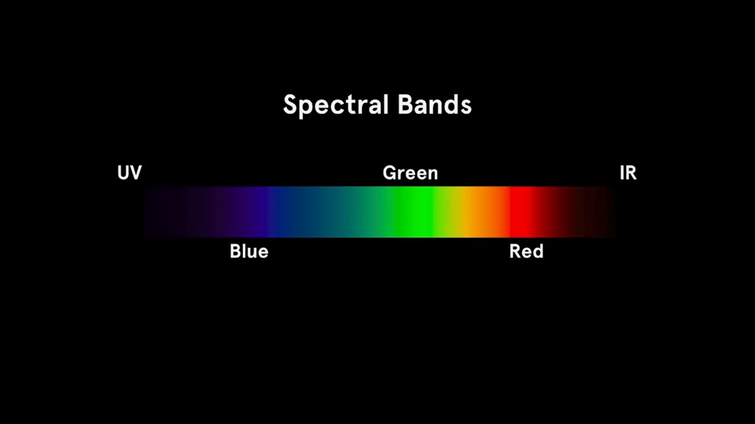
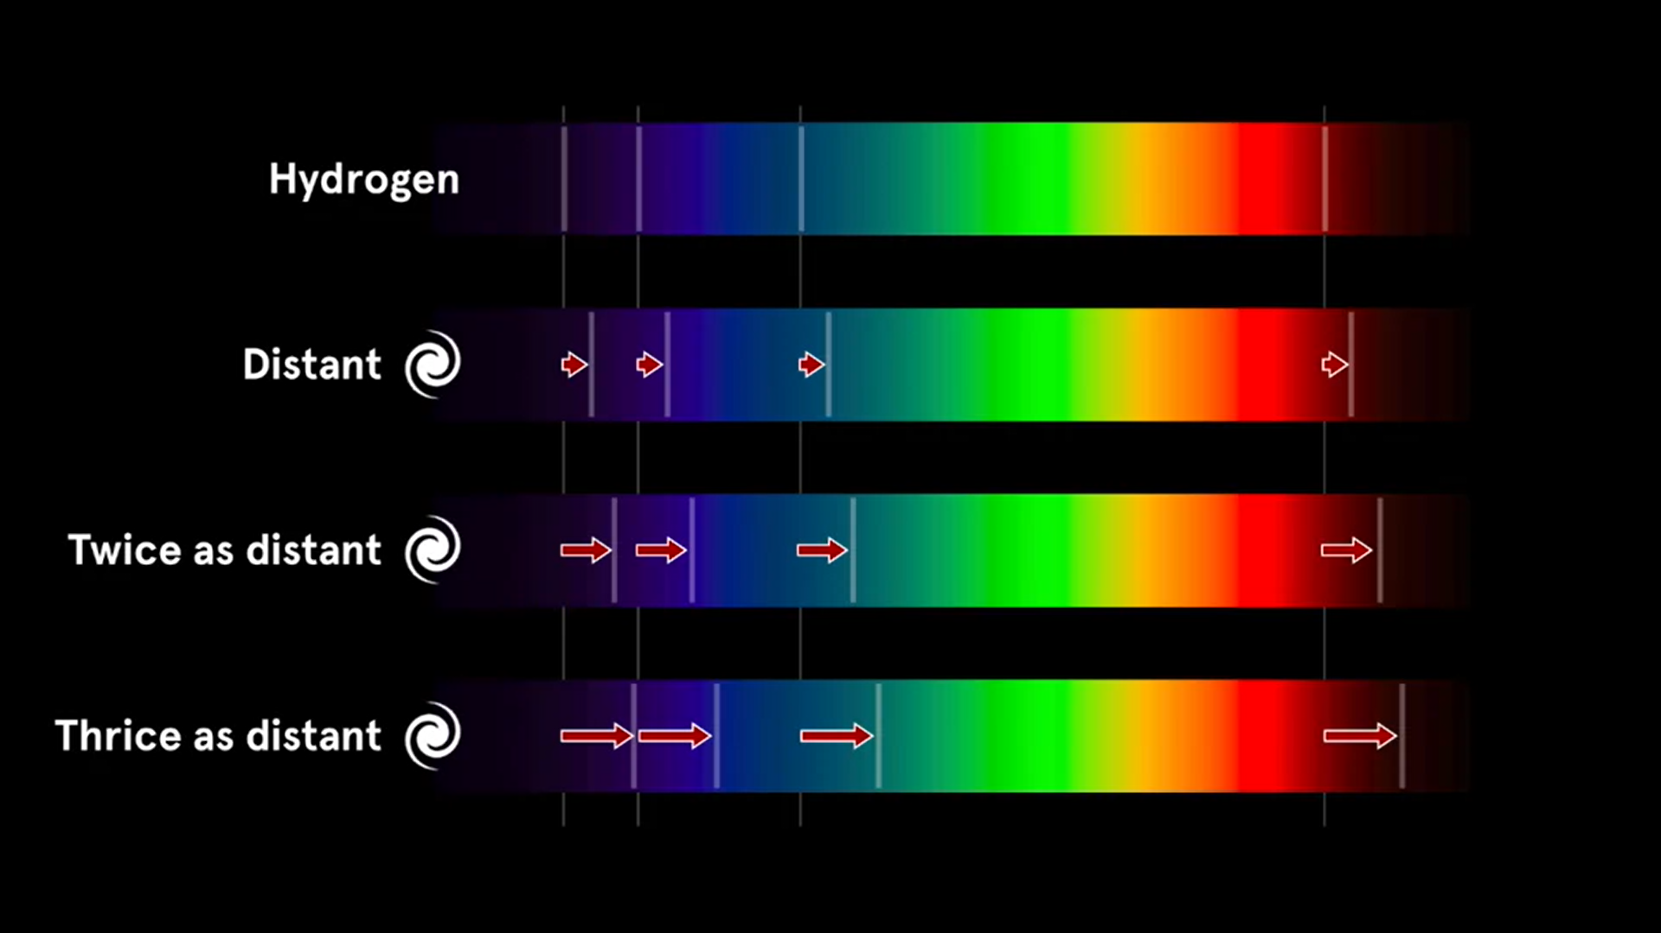
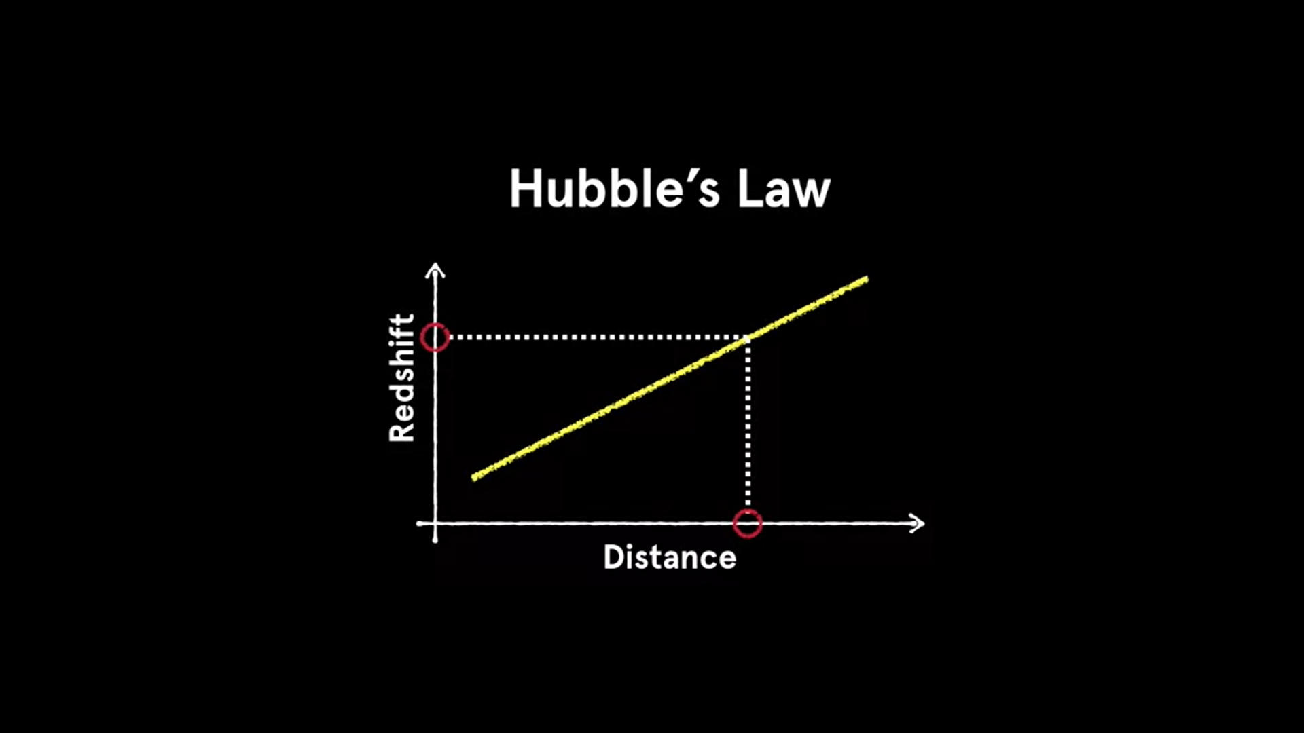
RELATIONSHIP BETWEEN
DISTANCE OF GALAXY AND
ITS REDSHIFT
HUBBLE’S LAW

Slide 14
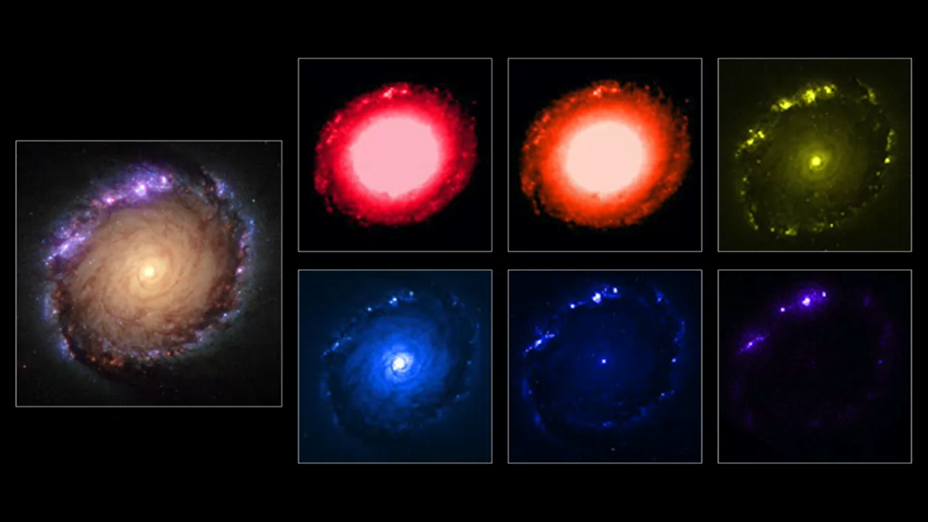
BROAD BANDS OF WAVELENGTH -
Infrared light or Red light, Green light, Blue light, near Ultraviolet light, Mid-Ultraviolet light

Slide 15
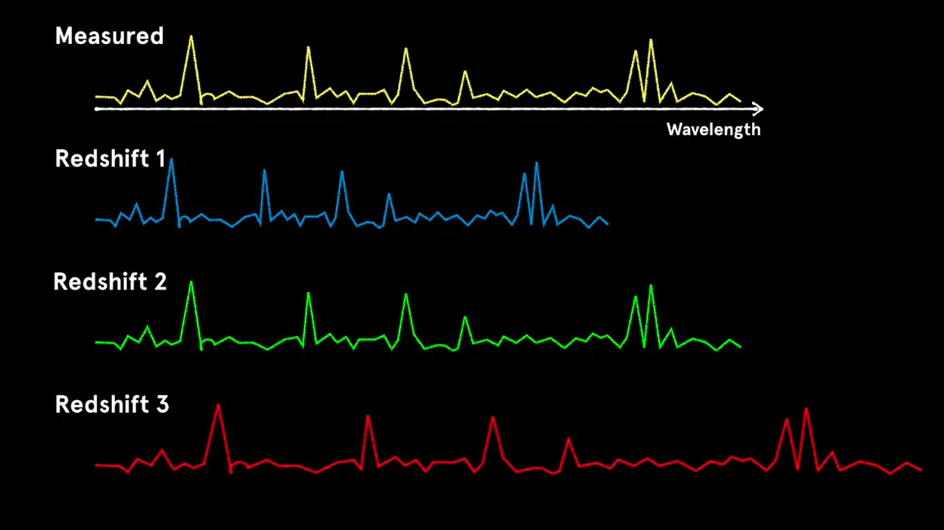
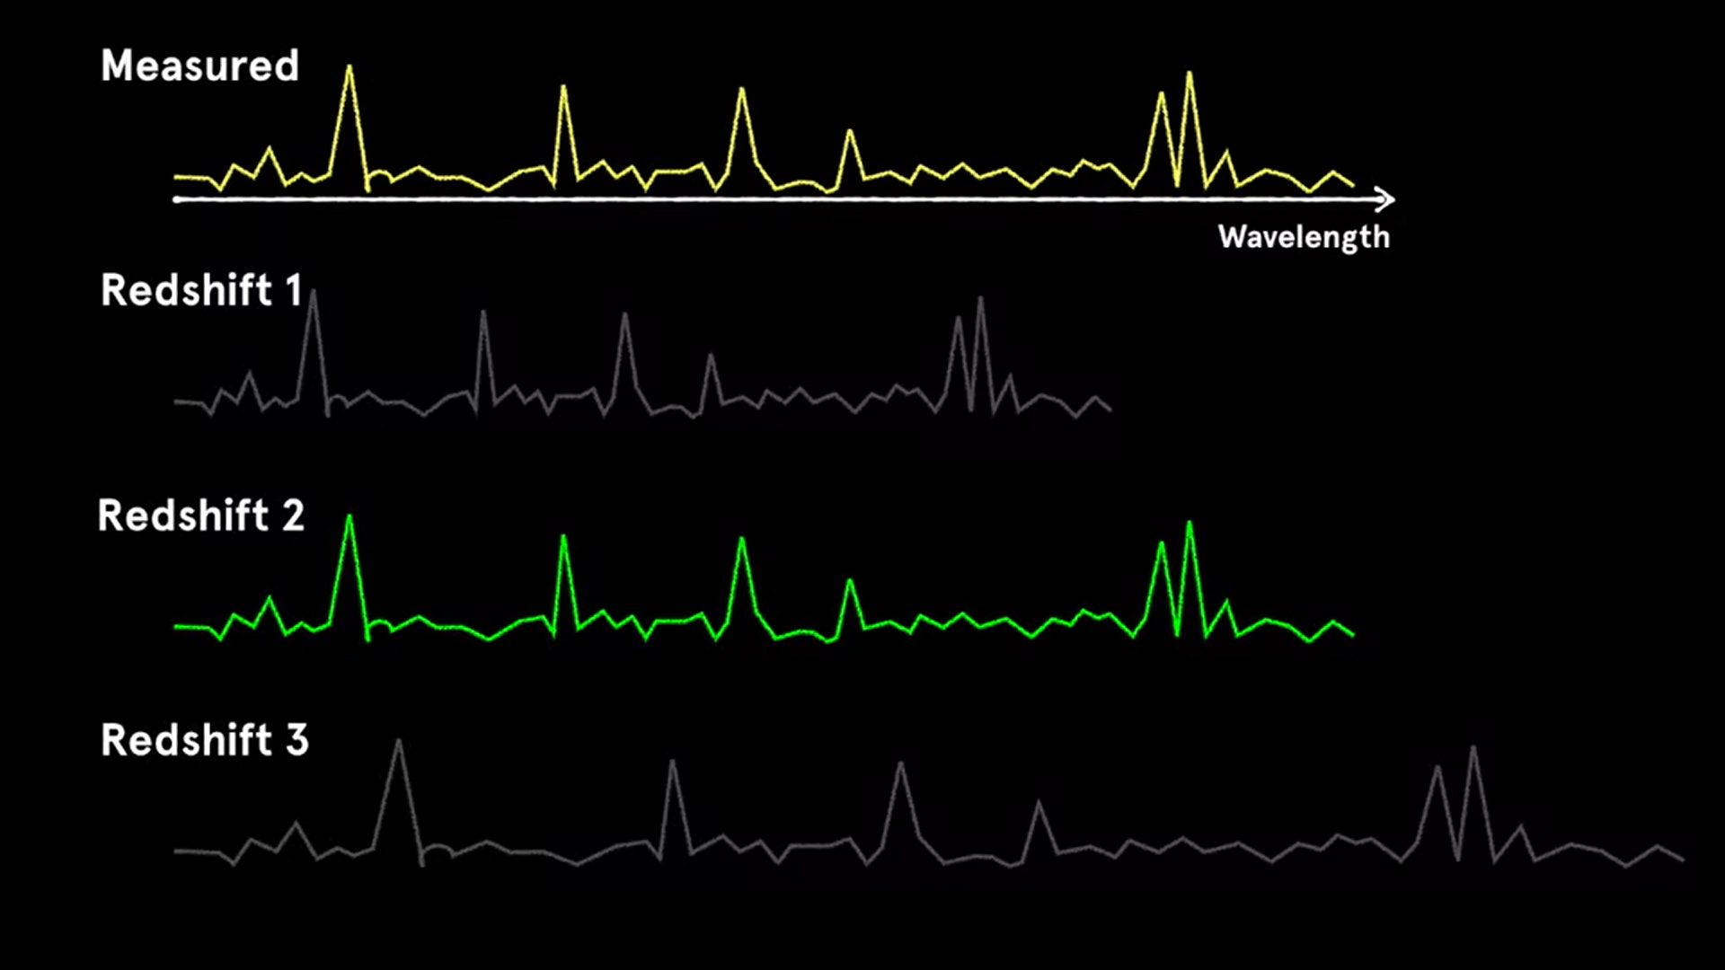
COMPARING WAVELENGTHS FROM STANDARD LIBRARIES
BEST MATCH FOR GIVEN REDSHIFT FOUND

Slide 16
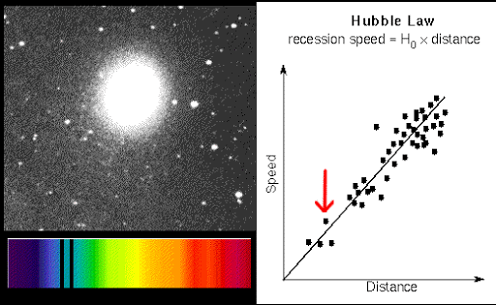
HUBBLE’S LAW :
Hubble's laws states that the velocity of recession between our galaxy and the other galaxies are directly proportional to the distance between them. The velocity of the galaxy which is also known as the redshift is directly proportional to its distance.
Hubble’s Law v=H₀d
Where,
v is the recessional velocity in km/s
Hο is the Hubble’s constant
D is the proper distance between the galaxy and the observer

Slide 17
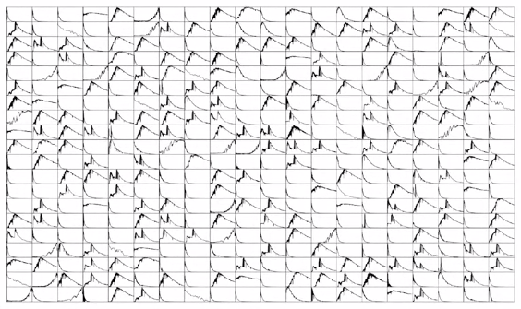
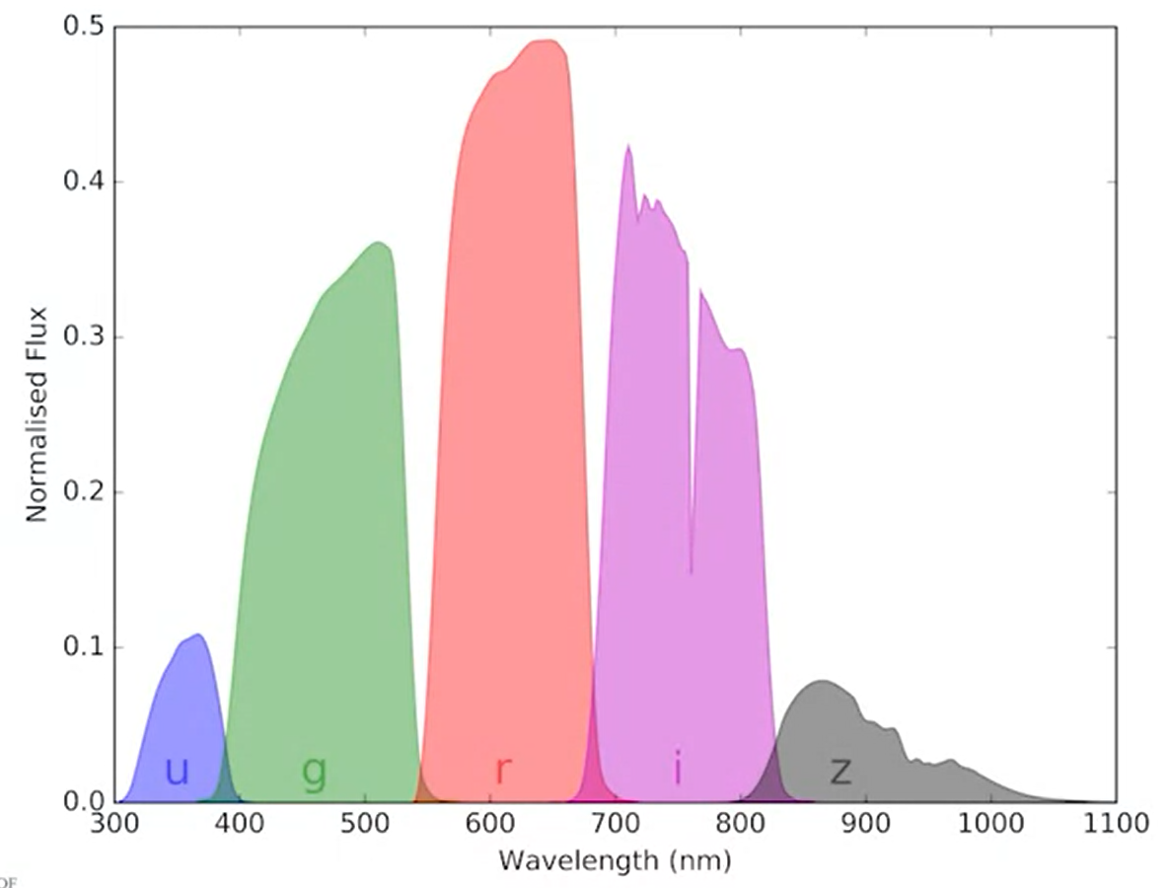
DATASET
Sloan Digital Sky Survey consisting of a sample of galaxies with measured spectroscopic redshifts known as the gold standard.
FEATURE EXTRACTION
Analyse colors measured by comparing the magnitudes from five different Sloan filters. U, G, R, I and Z. Each filter measures the light from the galaxy in a particular wavelength range. To calculate colors, astronomers subtract the magnitudes measured in neighboring filters. For example, U minus G or I minus Z.

Slide 18
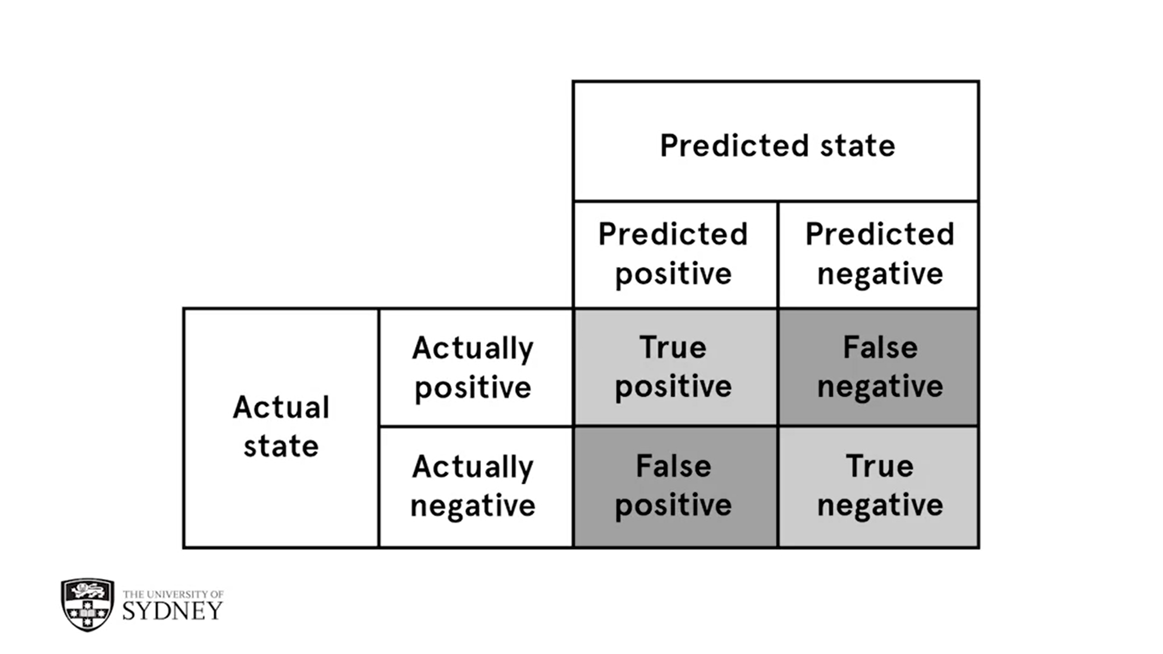
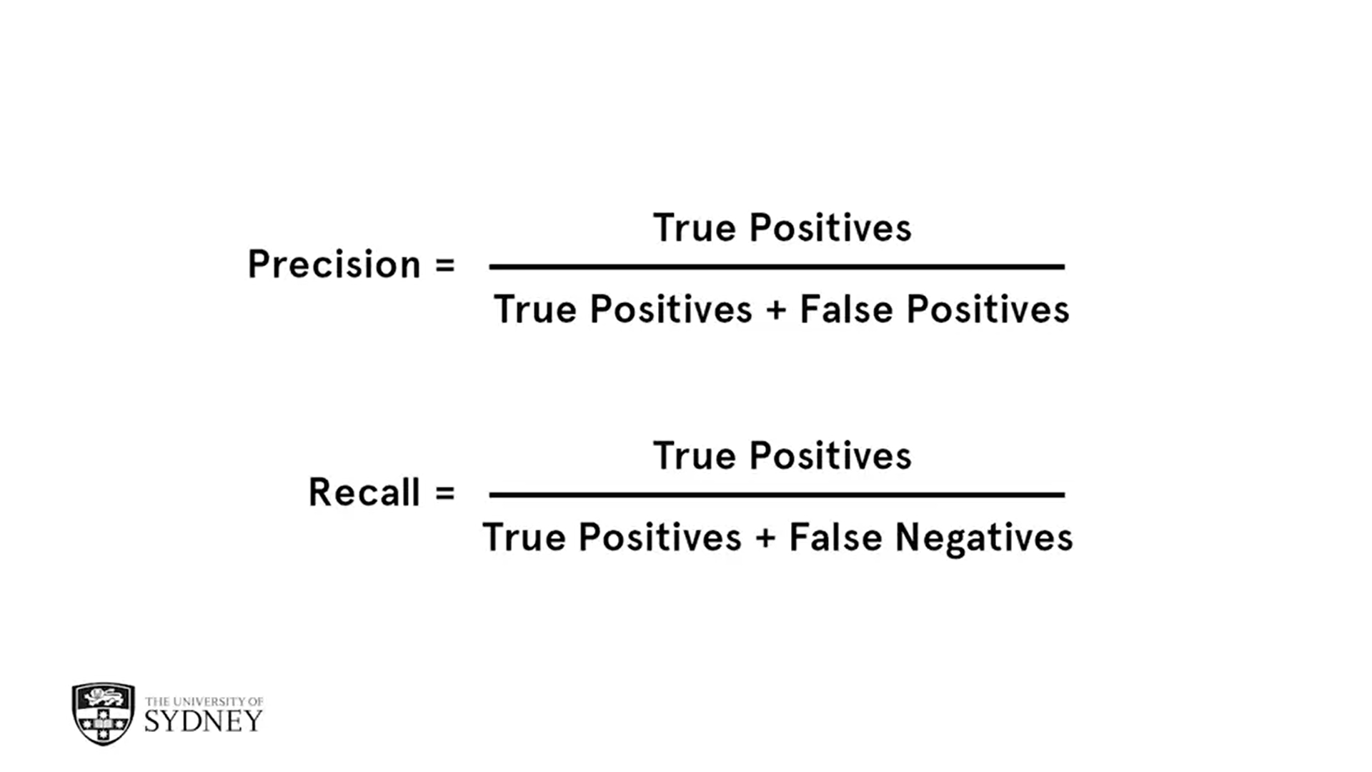
CLASSIFICATION ALGORITHM
Decision Trees to calculate the redshift of galaxies
TRAINING THE MODEL
Training the model on the known data set i.e building a model between the inputs and the result.
ACCURACY OF MODEL

Slide 19
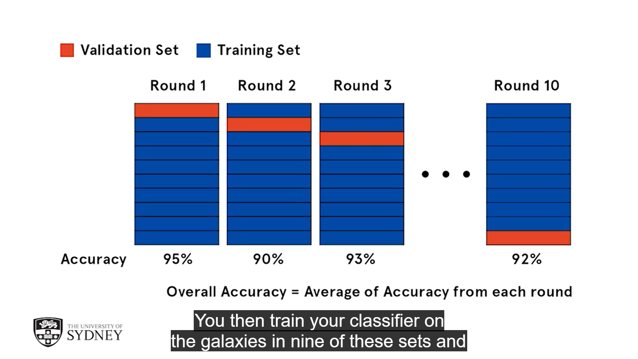
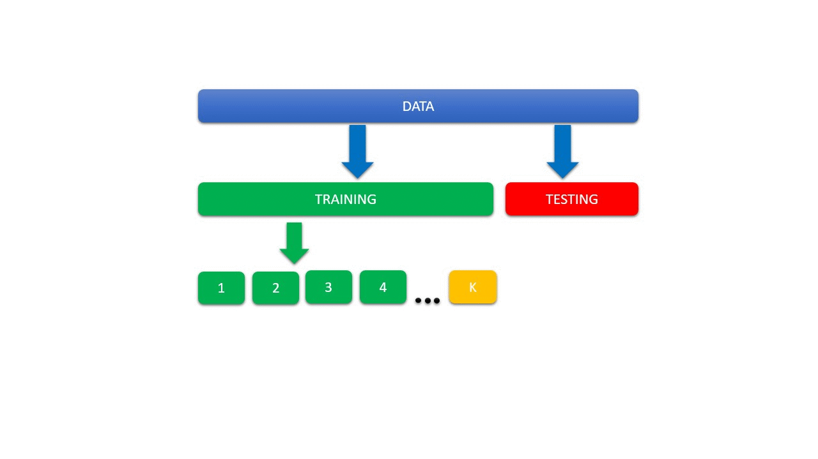
10-FOLD CROSS VALIDATION
Split the sample of galaxies with known redshifts into ten sets or folds, which are usually chosen randomly. Then train the classifier on the galaxies in nine of these sets and test it on the galaxies in the tenth set and record the precision and recall. You repeat this process for each fold and calculate the mean and the standard deviation. Model is now ready to be tested on unknown galaxies.

Slide 20
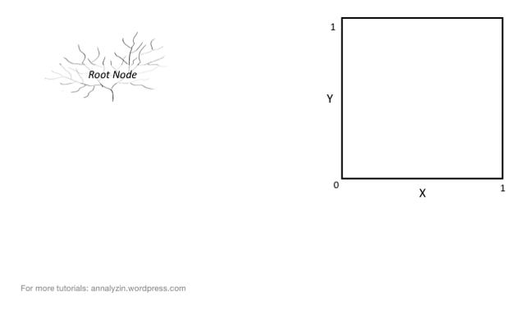
DECISION TREE
SELECTION OF ATTRIBUTES At each level, the attribute selected should be a question that maximizes the new information or minimizes the error. In astronomy, most of our data will be real valued.
ENTROPY Entropy measures how predictable or uncertain a distribution is. So if we have complete certainty, the entropy equals zero.
INFORMATION GAIN Information gain measures how much entropy is reduced by answering a particular question. What question should we have asked first to make the optimal split as the one that maximizes the information gain of that decision.

Slide 21
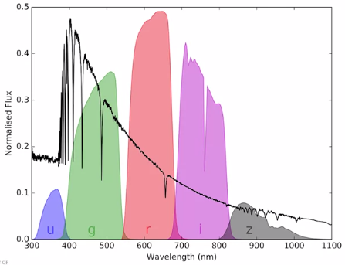
ESTIMATING REDSHIFTS USING DECISION TREE REGRESSION
The Sloan Digital Sky Survey measured the flux of each object using 5 optical and infrared filters between 300 and 1,100 nanometers. Each of these fluxes tells us how much light the object emits in that wavelength range.
The fluxes are converted to magnitudes also referred to by their filter names u, g, r, i and z.
The spectrum on this plot comes from bright star Vega, a blue white main sequence star about 25 light years away.
Distribution of total light emitted by a galaxy over the whole electromagnetic spectrum
Notes:
It's a very hot star with an effective temperature of about 10,000 Kelvin. Now we can say that it's brightest at short wavelengths.

Slide 22
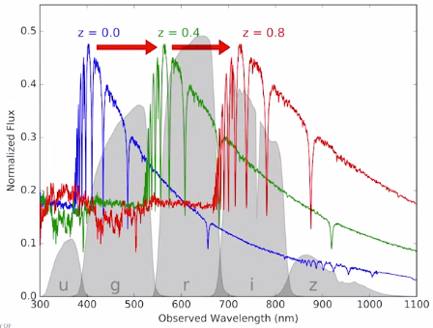
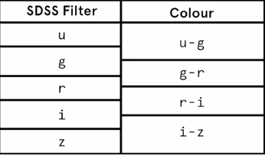
Silent Vega is actually much further away from us in a distant galaxy. The expansion of space means that light from Vega would be red-shifted and the same spectrum would now peak at longer wavelengths, hence the same filters on the telescope would measure different fluxes in each band.
The measured property we can use to quantify this are colors. Colors are the ratio of the flats measurements in neighboring filters, which is equivalent to subtracting the magnitudes. The five Sloan filters linked to four colors. u-g, g-r, r-i and i-z. A galaxy emits light with a spectrum that's basically the sum of all of the stars in the galaxy. The key to photometric redshift classification is that a red shifted galaxy will have different observed colors to what it would have at redshift zero.

Slide 23
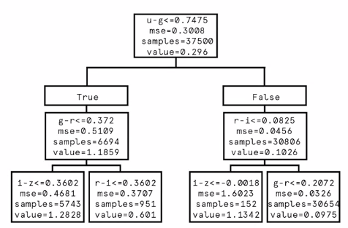
STEP 1: We take a large set of galaxies, say, 50,000, for which we have measured accurate spectroscopic red shifts and derived four photometric colors from this low magnitudes.
STEP 2: We then train a decision tree regressor that builds a model mapping the features, in this case the four colors. To the results, in this case the red shifts measured from spectroscopy.
TOP 3 LEVELS OF THE DECISION TREE REGRESSION

Slide 24
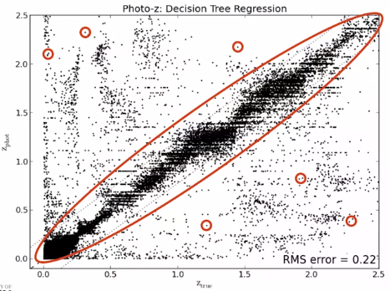
SCATTER PLOT
This plot shows the predicted red shift versus the true redshift for every single galaxy in the sample. We can see that most of the predictions are pretty good. The RMS scatter gives us an estimate of the accuracy of these predictions.
However, there are a lot of incorrect predictions (represented as small circles in graph), sometimes called catastrophic outliers where the model has gone horribly wrong.
These could be due to incorrect spectroscopic classifications, poorly calibrated colors, or cases were the galaxy is not well represented by the training data.
Zpred vs. Ztrue Plot

Slide 25

DRAWBACKS
We can now run a decision tree regressor on some galaxies for which we don't have spectroscopic redshifts.
But we have to remember that the regression accuracy is an overall estimate of how well the model works.
For each individual galaxy, we won't know whether we have a good estimate of the red shift or one of the catastrophic outliers.
Notes:
This is obviously a huge problem.

Slide 26
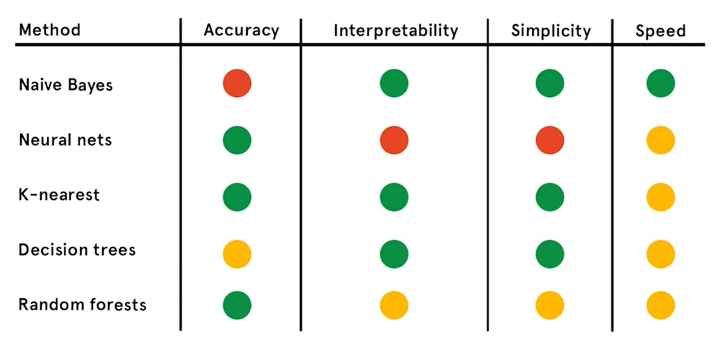
Bad
Average
Good

Slide 27
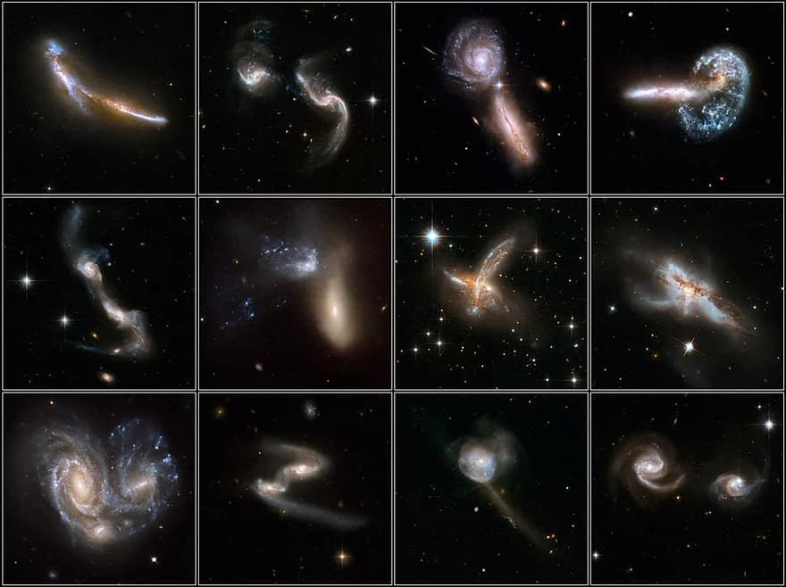
Classification of Galaxies

Slide 28
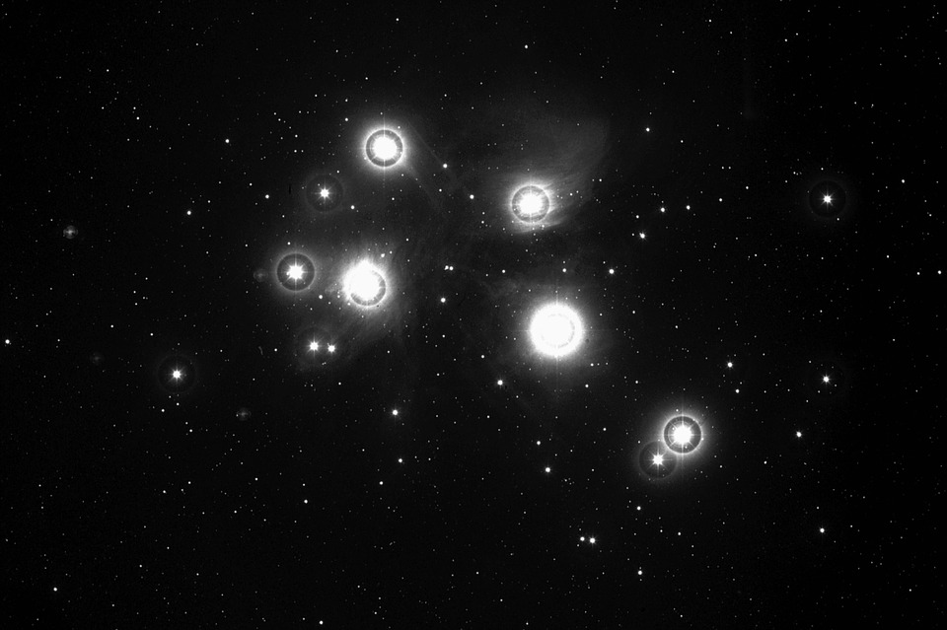
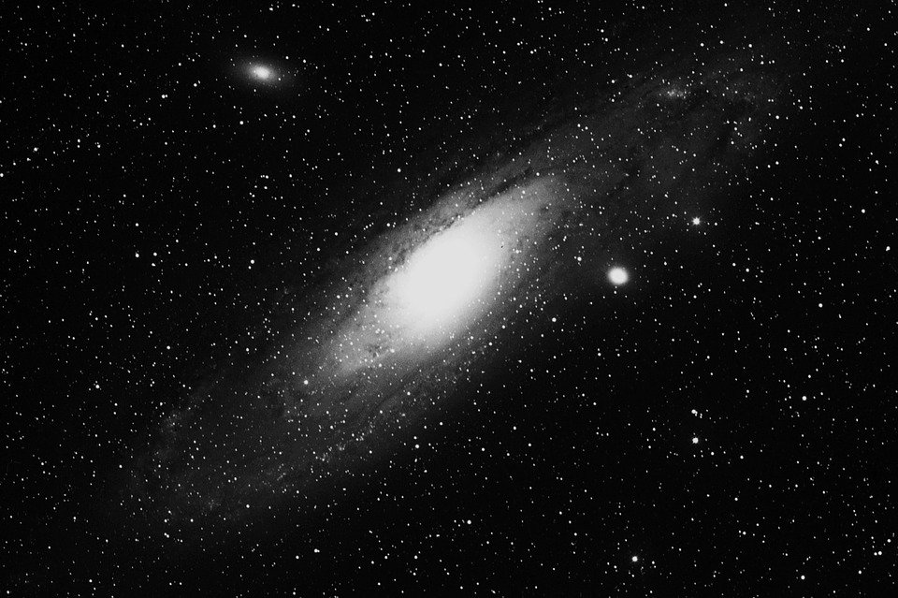
Introduction to classification
The process of classification involves sorting through the photographs, identifying key features of each galaxy.
The more conspicuous examples of each type were then used as what we now call archetypes of each class. And the other galaxies were compared to them in order to classify them.
We use decision tree algorithm for this, and improve the classification result using random forest classifier.
Hubble used this approach to classify hundreds of galaxies. And in the process, developed one of the most famous classifications schemes in astronomy. The Hubble Sequence or the Hubble tuning fork diagram.

Slide 29
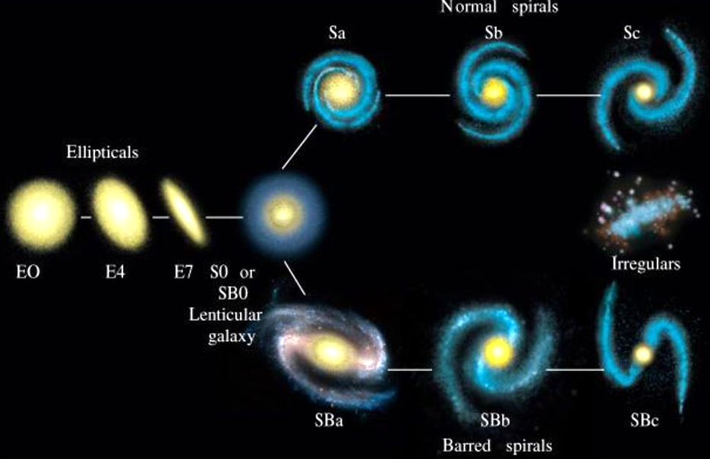
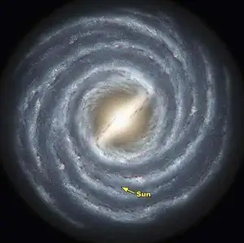
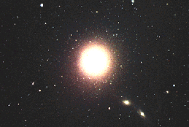
In this scheme, Hubble described the visual properties of galaxies, their morphology or shape, ranging from regular, elliptical, and spiral shaped galaxies, to what appeared to be irregular collections of stars and gas. Hubble's scheme has been widely used and widely reinterpreted and misinterpreted. But the underlying morphological descriptions still stand today as a useful way of describing galaxies. What's more? These morphological classifications turn out to be correlated with important physical properties of galaxies. Such as their star formation rate, which helps us understand galaxy formation and evolution.

Slide 30
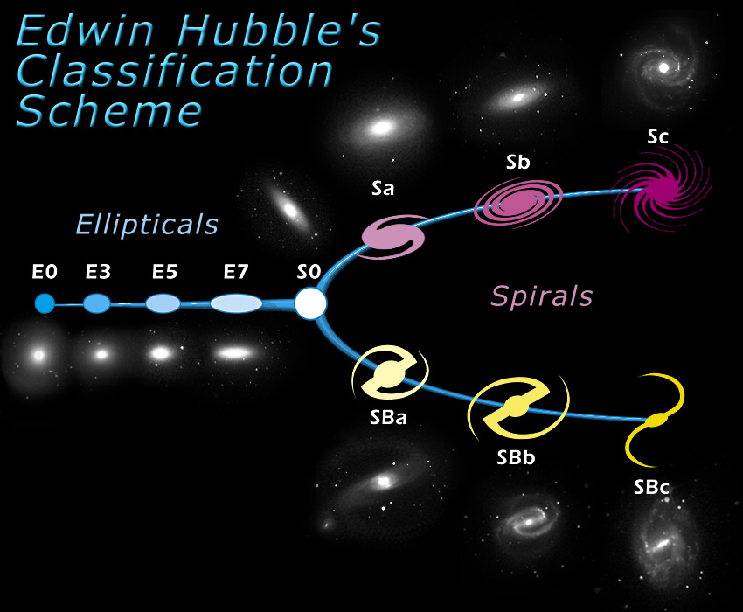
Types of galaxies
First, we understand the types of galaxies using Hubble’s tuning fork:
Hubble divided galaxies into
elliptical galaxies
spiral galaxies
intermediate lenticular
Elliptical and lenticular galaxies are called early -type galaxy because of their similar appearance
Spiral galaxies are called late type galaxies because of their complex structures
Intermediate lentricular

Slide 31
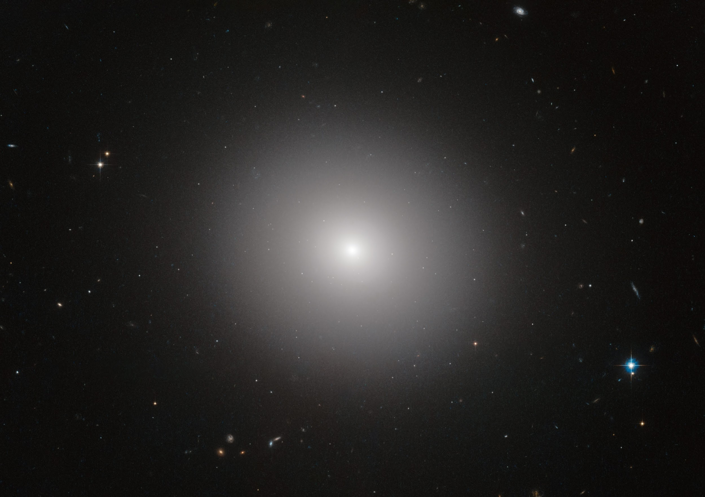
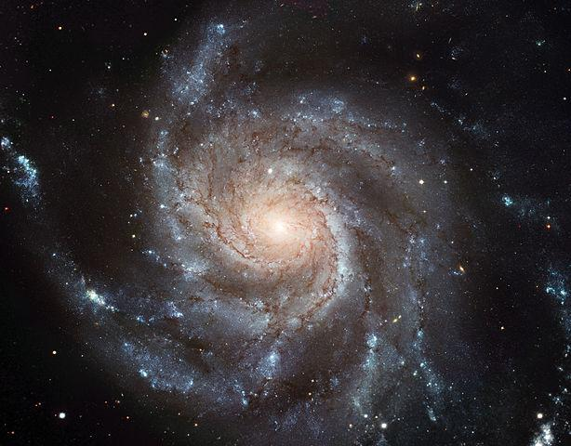
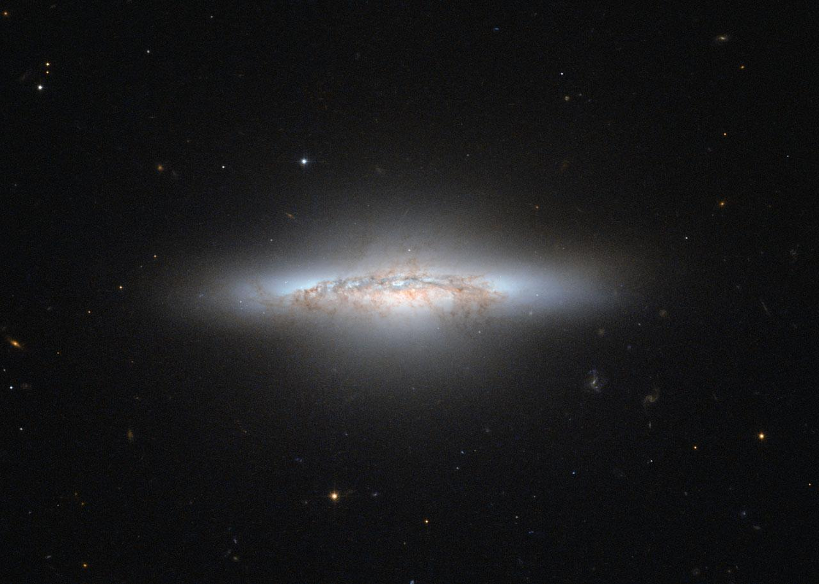
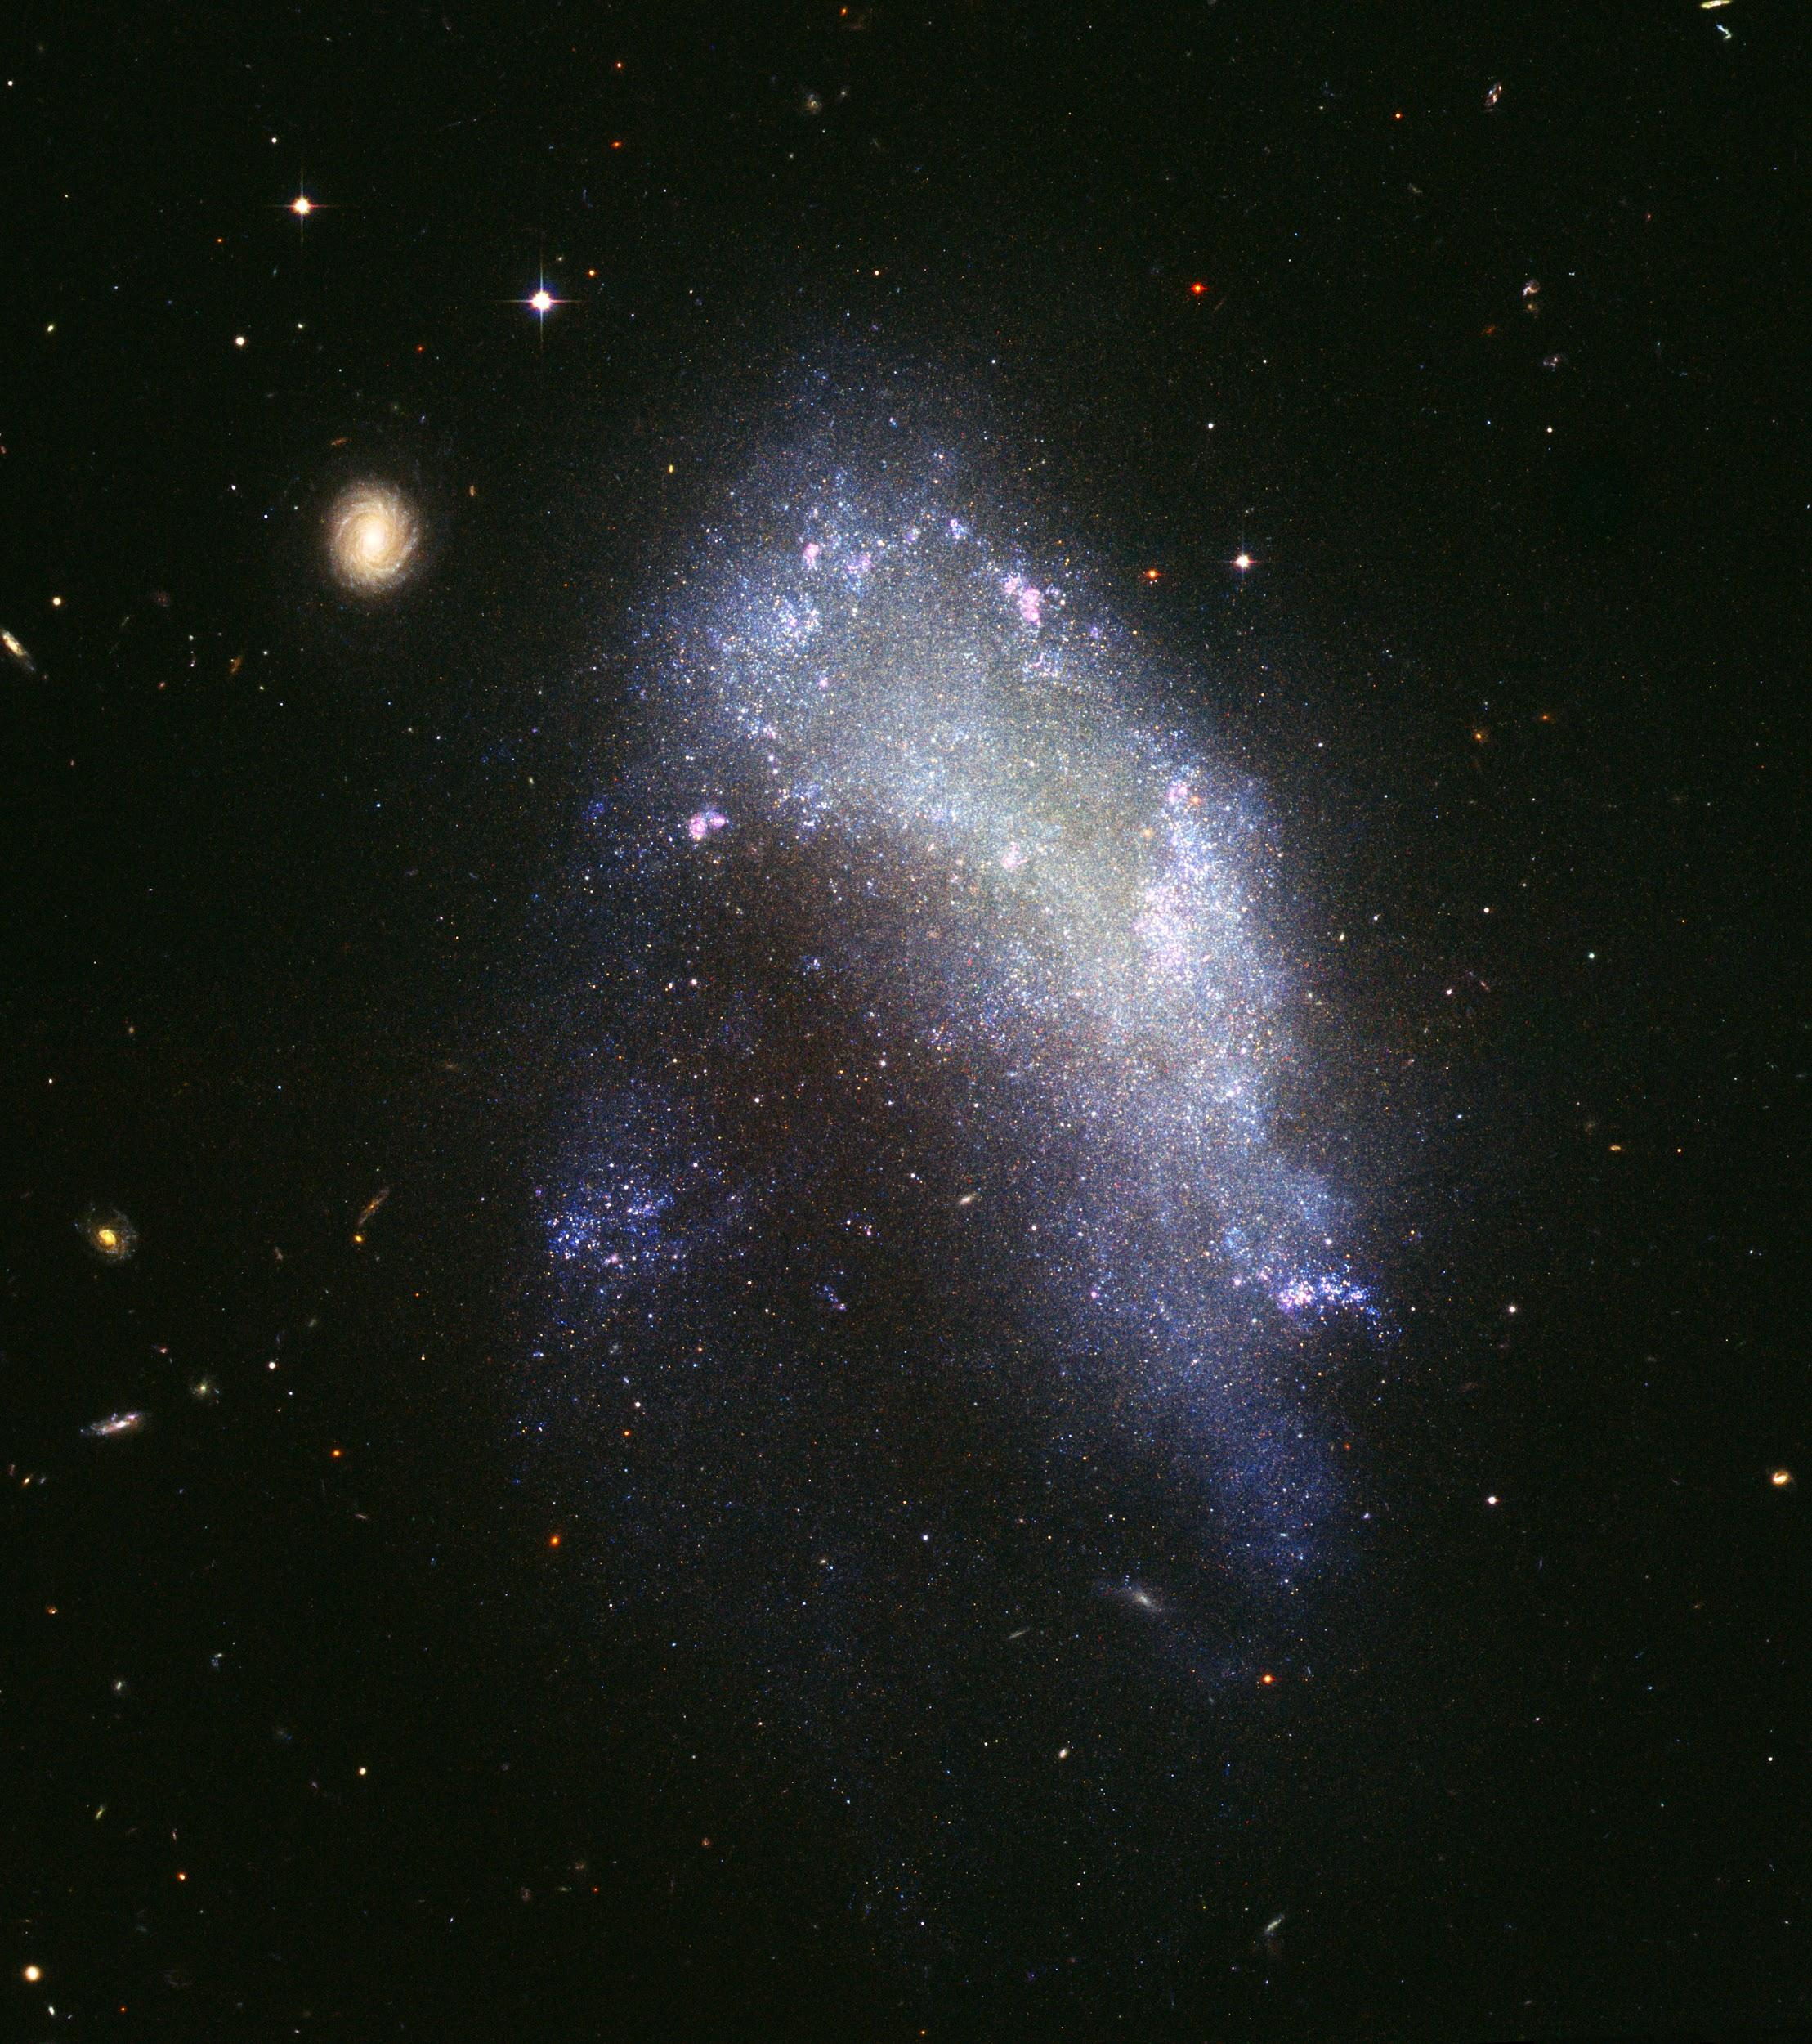
Elliptical Galaxy
Spiral Galaxy
Lenticular Galaxy
Irregular Galaxy

Slide 32
As more and more galaxies were found, particularly in the 19th and early 20th centuries, astronomers observed that they had a great diversity in appearance otherwise known as morphology. As a first step to understanding how galaxies formed and evolved, astronomers began grouping them together based on similar appearances, forming a Morphological Classification Scheme.
The most famous of these is the Hubble tuning fork. Hubble divided galaxies into elliptical galaxies and spiral galaxies with the intermediate lenticular, or S zero class in between. Elliptical and lenticular galaxies are collectively known as early-type galaxies, because of their simple appearance. Spiral galaxies are known as late-type galaxies, because of their complex structure.
Elliptical galaxies have a smooth, spheroidal appearance with little internal structure. They're dominated by a spheroidal bulge and have no obvious thin disk. Elliptical galaxies are divided into subclasses based on their apparent flattening. E0 galaxies are circular, through to E7 galaxies, which are highly elongated. On the far right of the diagram, the Sd class of spiral galaxies are essentially the opposite, with a prominent disc and no clear central bulge. Most obviously spiral galaxies all show spiral arms, though, when viewed edge on the arms may not be visible. As we move back along the Hubble tuning fork, we find spiral galaxies with increasingly large bulges, and more tightly wound arms, when seen face on.

Slide 33
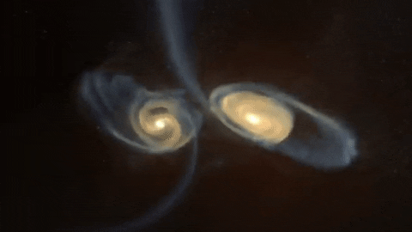
The lenticular class have similarities with both spiral and elliptical galaxies. They have a prominent bulge and a prominent disc but no spiral arms. The rectangular looking structure found in the center of many galaxies are called bars. Both lenticular and spiral galaxies are also coming barred and unbarred varieties giving rise to the two prongs of a tuning fork. And finally, there is a class of irregular galaxies that don't fit any of the previous described types. These are mainly low mass galaxies that are highly asymmetric with very chaotic structures. Other galaxies that may sometimes be put into this category are merging galaxies where two galaxies are in the process of crashing into one another leading to very dramatic morphologies.
Notes:
We're going to use one of the newest techniques in astronomy to automatically implement one of the oldest classification schemes. We'll start out using a decision tree algorithm, but then explore some of the limitations of decision trees. And see if we can improve our classification results using a more sophisticated approach, ensemble learning with a random forest classifier.

Slide 34
More information about different types of galaxies:
Out of all galaxies, ⅓ of them are elliptical.
Elliptical galaxies - They are red or yellow in colour because they mostly contains old stars. They possess as little dust and gas, due to which they tend to live longest than other galaxies.
Spiral galaxies - They appear flat blue and white disks of stars, gases and dust with a white bulge in the center. They are further classified as barred and normal spirals. In here stars are actively forming and dying. They possess a lot of energy and are short lived.
Irregular galaxies - these galaxies are neither elliptical or spiral. They have very less dust and were present before elliptical or spiral galaxies.

Slide 35
Classification
How are we classifying images?
We use sloan digital sky survey.
The galaxies fall into three classes : elliptical, spiral and irregular
So we take images taken from five sloan filters for each individual galaxy
The decision tree algorithm uses our training set to build a model to map these features to the correct classifications. We'll use ten fold cross validation to evaluate the accuracy of our classifier before applying it to unknown data.
But the main question is how can we best represent the galaxies in our sample - feature selection
The features we might use for automatic classification - the simplest option is to use every pixel of the image taken - so if we use an image of 256x256 pixel image, each galaxy would be represented by 65536 features.

Slide 36
Advantage:
This method is simpler as we need not use any sophisticated image analysis.
Disadvantages:
The computational cost
But what features should we use?
So we can include, the colour of the galaxy - as they tell the age of the stars in the galaxy
The ellipticity of the galaxy
The luminosity of the galaxy - that is the distance of brightness emitted from the radius
Using these features we train our model.

Slide 37
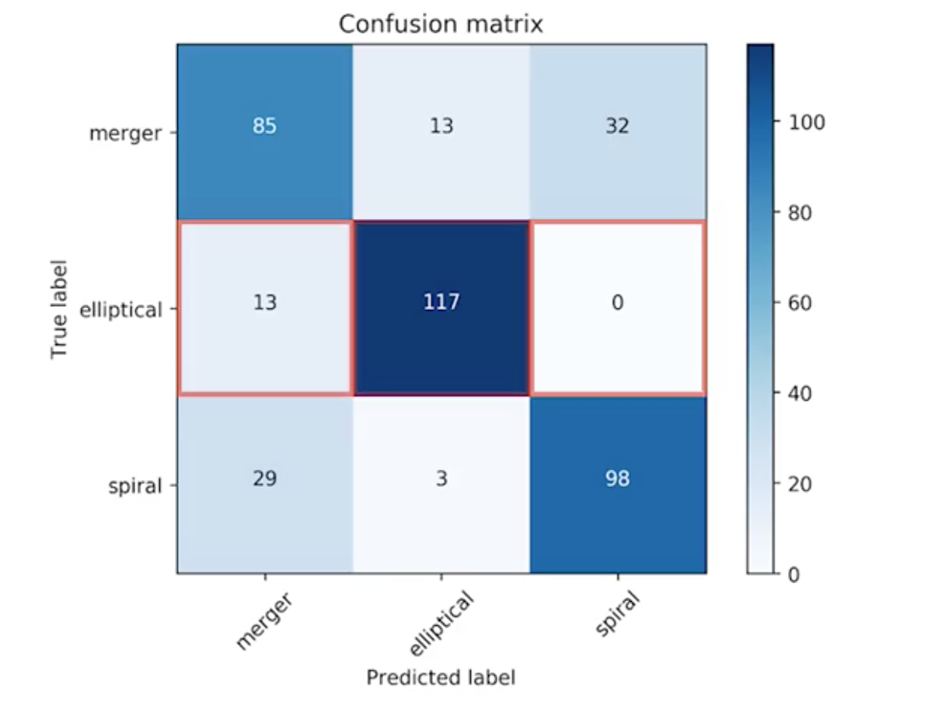
Limitations of decision tree
How do we know which galaxies are hardest to classify accurately?
To answer this we use confusion matrix
confusion matrix - A confusion matrix visualizes the relationship between the true labels from our gold standard and the predicted labels from our classifier.
This confusion matrix depicts that it is harder to differentiate between irregular and spiral galaxies. And although the accuracy is good, but we can still improve it.

Slide 38
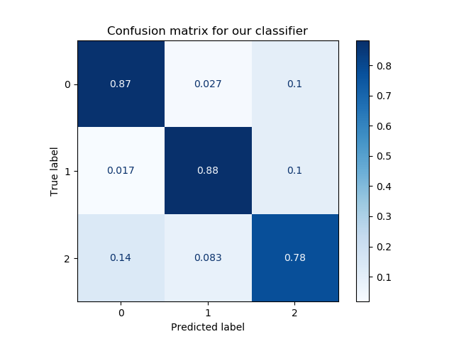
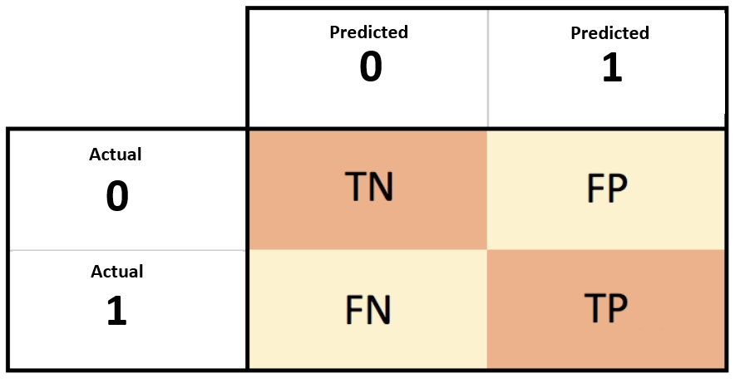
Confusion Matrix
It is a table that describes the performance of a classifier.
In here, we compare our true values to predicted values.
To define the terms:
true positives (TP): These are the cases we predicted yes, and the result was “yas”
true negatives (TN): These are the cases we predicted no, and the result was “no”
false positives (FP): We predicted yes, but the result is “no”.
false negatives (FN): We predicted no, but the result is “yes”.

Slide 39
Now with this classification the, accuracy can vary enormously based on how we divide the training and testing dataset.
One of the reasons for this instability is that decision trees are highly susceptible to noisy training data and have a tendency to overfit.
To reduce this instability, we make use of ensemble classifier where multiple models are trained and their results are combined to give a more accurate output.
For ensembles to work better than individual classifiers, the members of the ensemble must be different in some way; they must give independent results. If they all gave the same predictions on each instance, then having more of them would make no difference at all.
A random forest classifier is a supervised machine learning algorithm that uses an ensemble of decision tree classifiers. It builds an ensemble by randomly selecting, either subsets of training instances, bagging, or selecting a subset of features of each decision point.

Slide 40
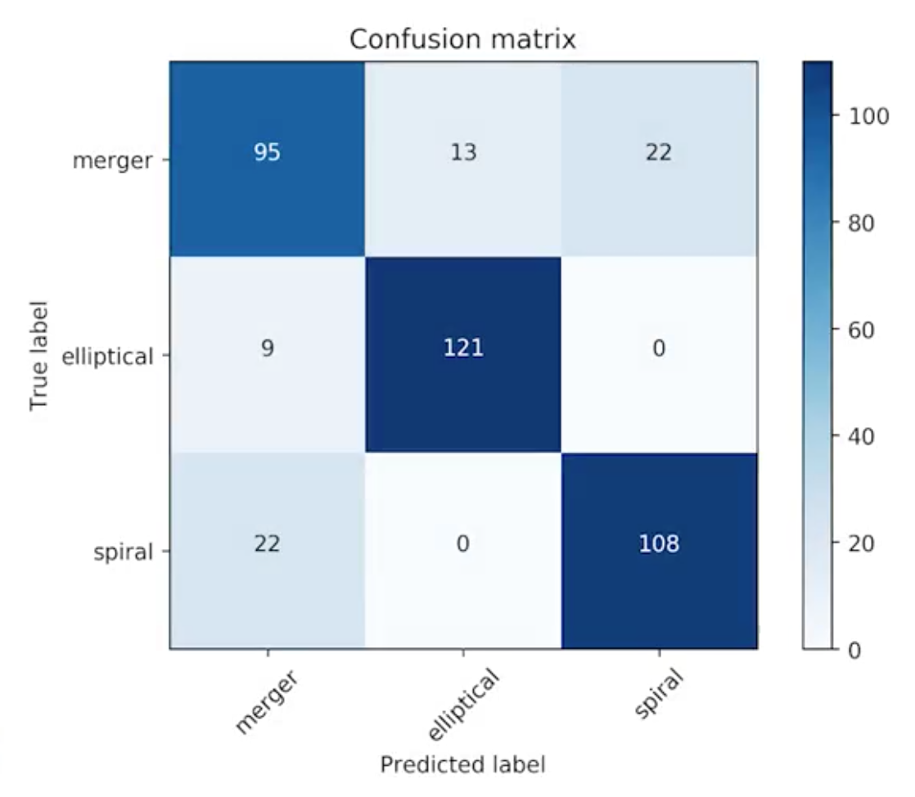
We use the same methodologies but then replace the decision tree classifier with random forest classifier.
A larger number will use more samples from the original data and will be more robust to noise and overfitting.
This also identifies out-liners, the objects which are not similar to any of the training classes.
Using confusion matrix to see the result. And the results are substantially better.

Slide 41
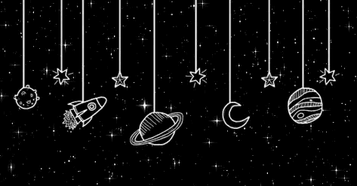
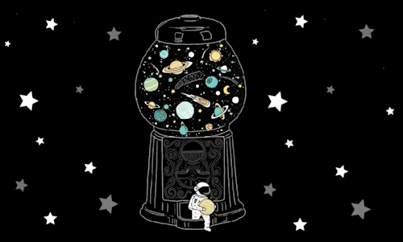
NOVELTY
OF THE PROJECT

Slide 42

For the best possible classifications and predictions, we usually want to combine machine learning algorithms with astronomy knowledge about the problem.
We have looked at how decision trees are prone to overfitting the model and how limiting the maximum depth of the tree can be used to prevent this.
We also explored some of the limitations of decision trees and saw we can improve our classification results using a more sophisticated approach, ensemble learning with a random forest classifier.

Slide 43

REAL
TIME
USAGE

Slide 44
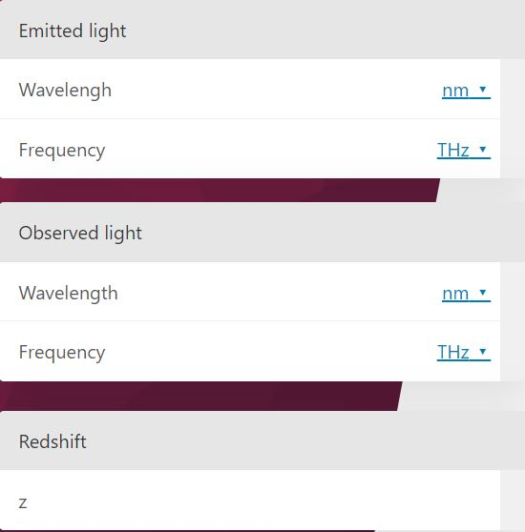
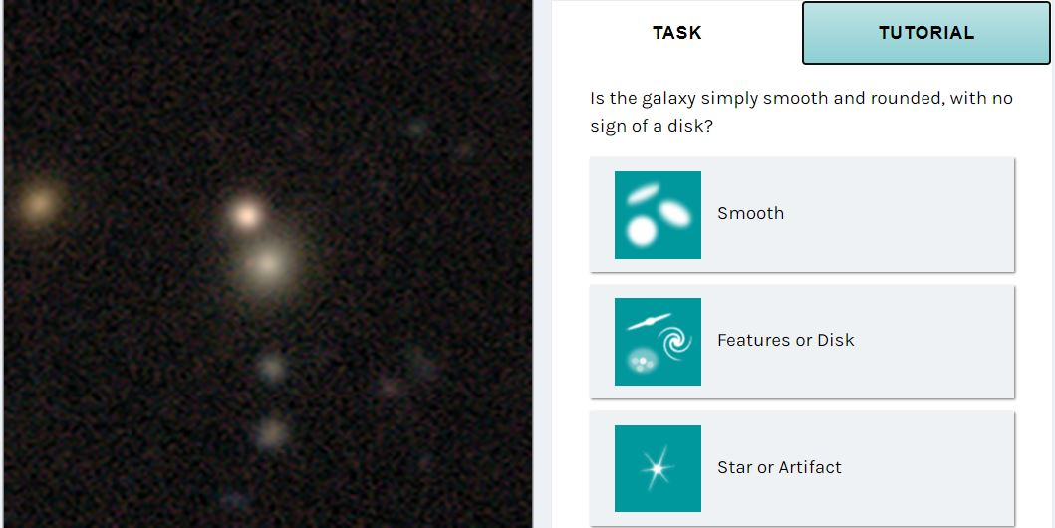

Omni calculator for Redshift calculation
Galaxy Zoo - Classify some galaxies by hand
https://www.omnicalculator.com/physics/redshift
https://www.zooniverse.org/projects/zookeeper/galaxy-zoo/classify
The redshift calculator helps to estimate the redshift parameter z. The discovery of the redshift in astrophysics has become a crucial point in understanding the history of our universe. In the further text, it explain what redshift is and how to estimate its magnitude using the mathematical redshift definition.
Galaxy Zoo is a platform where an individual person can classify the type of Galaxies based on his/vision. The software displays the picture from a dataset and user have to select an option from the given list based on the appearance of the image. This image is then displayed to more users for better prediction accuracy.

Slide 45


HARDWARE AND SOFTWARE REQUIREMENTS
Hardware:
PCs or Laptop
Software:
Python Language
Jupyter (with pre-installed packages).

Slide 46
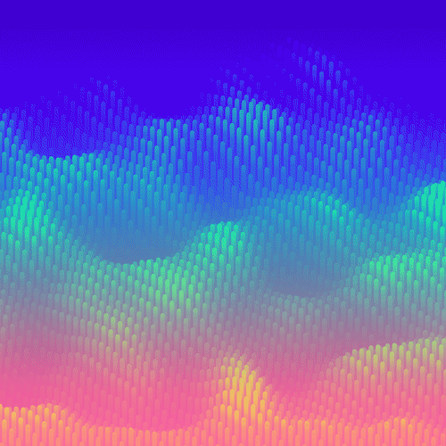
OVERALL SYSTEM ARCHITECTURE DIAGRAM

Slide 47
Calculating Redshifts
DATASET USED
SLOAN DIGITAL SURVEY
TRAINING DATA
KNOWN SPECTROSCOPIC REDSHIFTS DEPICTED BY GRAPHS OF LIGHTS EMITTED FROM GALAXIES VS WAVELENGTH
MODEL MAPS COLOURS TO PREDICT REDSHIFT
TRAIN DECISION TREE REGRESSOR
TEST THE MODEL AND MEASURE ITS ACCURACY
USE HUBBLE’S LAW TO COMPUTE DISTANCE OF GALAXY FROM THE PREDICTED REDSHIFT

Slide 48
Classification of Galaxies
Classify the data using sloan digital sky survey
Images are taken from five sloan filters for each galaxy
The decision tree algorithm uses our training set to build a model to map these features to the correct classifications.
We use an ensemble classifier such as random forest for better accuracy
We decide the features on which our model will be trained
We use ten- fold validation for accuracy of our classifier
The output is visualised using Confusion matrix

Slide 49

First Review

Slide 50

LITERATURE REVIEW

Slide 51
Estimating Redshifts
Model 1- The standard techniques estimate redshifts using post-processed features, such as magnitudes and colours, which are extracted from the galaxy images and are deemed to be salient by the user. This method removes the user from the photometric redshift estimation pipeline. However we do note that Deep Neural Networks require many orders of magnitude more computing resources than standard machine learning architectures.
Model 2- Photometric redshifts (photo-z) are crucial to the scientific exploitation of modern panchromatic digital surveys. In this PhotoRApToR (Photometric Research Application To Redshift): a Java/C++ based desktop application capable to solve non-linear regression and multivariate classification problems, in particular specialized for photo-z estimation. It embeds a machine learning algorithm, namely a multilayer neural network trained by the Quasi Newton learning rule, and special tools dedicated to pre- and post processing data.
Model 3- The redshift estimation is performed by comparing predefined regions in the spectra and applying a k nearest neighbor regression model for every predefined emission and absorption region, individually.

Slide 52
Classifying Galaxies :-
A. Galaxy Image Classification and Citizen Science-
There are two main morphological types based on the presence or not of a disk: spiral and elliptical, respectively. However, the multiplicity of hybrid types and the wide range of image conditions depending on factors such as the galaxy brightness, size or distance, turn the classification of this sort of images into a very complex task.
Citizen science has been a partial solution for this problem, with the engagement of amateur people from the general public in this kind of data analysis . Citizen science projects join the endeavours of myriads of volunteers committed to helping with a task that typically is time consuming and tedious for experts, but also decisive for getting advances in a certain research problem.

Slide 53
Classifying Galaxies :-
B. Feature Extraction Plus a Classifier-
Among the first, we review the use of physical parameters extracted from the image, whereas the second category is dominated by the WND-CHARM feature set, originally developed as an image analysis tool for the classification of biological images, WND-CHARM represents the state-of-the-art feature extractor for the classification of galaxy images. First, through a FE phase, it computes a set of families of features from the raw images in a one by one fashion. These are categorised as image content descriptors, image transforms, and compound image transforms (transformations of a previous image transformation), composing a feature vector for the image at hand. Depending on the presence or not of colour in the image, two feature sets are available. Then, a feature selection (FS) phase chooses the most informative subset by calculating the Fisher discriminant score of each feature. Finally, the resulting feature vectors are classified using a modified nearest neighbour (NN) rule that weights the distances using the Fisher scores previously computed. Whereas in traditional NN only the closest (or k closest) examples determine the class, with WND-CHARM the distances to all training samples of each class are measured.

Slide 54
Classifying Galaxies :-
C. Convolutional Neural Networks-
A simpler CNN architecture to distinguish between the two main morphological types. We test this model against a well-established deeper model, ResNet, and explore how their performances are affected by the number and size of the images as well as the presence or not of colour channels. We then compare these results with the classification using FE plus classifier, aiming to investigate in which occasions the different approaches work better. Additionally, we also explore the pre-training of both CNN models considered by exploiting the availability of expert and amateur labels within citizen science data, which to the best of our knowledge has not been investigated before.

Slide 55

Module Description
&
Module Workflow Explanation

Slide 56

The Regression Model

Slide 57
Task 1- Importing Libraries
Task 2- Load the data and Generate Feature Targets
Task 3- Implementation of the function median_diff
The function should calculate the median residual error of our model, i.e. the median difference between our predicted and actual redshifts. The median_diff function takes two arguments – the predicted and actual/ target values. When we use this function later, these will corresponding to the predicted redshifts from our decision tree and their corresponding measured/target values.

Slide 58
Task 4- Splitting of data & Validation of decision tree model
Here, we will use median_diff from the previous question to validate the decision tree model. Your task is to complete the validate_model function.
Task 5- Plot the decision tree
Task 6- Defining color indexes and plotting the redshift graph

Slide 59
Task 7- Overfitting Trees & Maximum Depth
Accuracy of the decision tree on the training set gets better as we allow the tree to grow to greater depths. Conversely, the accuracy measure of the predictions for the test set gets better initially and then worse at larger tree depths where it starts to overfit the data. This means it tries to take into account outliers in the training set and loses its general predictive accuracy.
Overfitting is a common problem with decision trees and can be circumvented by adjusting parameters like the tree depth or setting a minimum number of cases at each node.
Task 8 - K-Fold Cross Validated Predictions
K-Fold cross validation is an important part of assessing the accuracy of any machine learning model. When we plotted our predicted vs measured redshifts we are able to see that for many our galaxies we were able to get a reasonably accurate prediction of redshift. However, there are also several outliers where our model does not give a good prediction.

Slide 60


The Classifier Model

Slide 61
Task 1 Import the libraries
Task 2 Splitting the data
The data is splitted into 70% training dataset and 30% testing dataset.
Task 3 Generate feature target
Task 4 Training the decision tree classifier
Here, we train the classifier with train features and train targets and get the prediction for test features. We get the information about predicted class and actual class.

Slide 62
Task 5 Work on the decision tree classifier
Here, we first create a function that plots the confusion matrix. Confusion matrix is a table used to measure the performance of classifier(in this case the Decision tree classifier) on a set of test dataset for which the true values are known. We also make a function that calculates the accuracy.
Task 6 Random forest classifier
We create a function that predicts the actual value, using the 10-fold validation and cross_val_predict. We instantiate random forest classifier and calculates the accuracy score using the function. After getting the accuracy score, we plot the confusion matrix.

Slide 63

Implementation and Coding with Snapshot of Project

Slide 64

Building a
Regression Model

Slide 65


Slide 66


Task 1
Task 2

Slide 67

Task 3- Implementation of the function median_diff

Slide 68


Slide 69


Task 4- Splitting the data & Validation of decision tree model

Slide 70

Task 5- Plot the decision tree

Slide 71


Slide 72


Task 6- Defining color indexes and plotting the redshift graph

Slide 73


Task 7- Overfitting Trees & Maximum Depth

Slide 74


At a tree depth ~19 the decision tree starts to overfit the data. For now, we will set a maximum tree depth of 19 to prevent over-fitting in our redshift problem.

Slide 75



Task 8 - K-Fold Cross Validated Predictions

Slide 76
Building a
Galaxy Classifier

Slide 77


Slide 78



Task 1
Importing the libraries
Task 2
Splitting the data

Slide 79



Task 3
Generate feature target

Slide 80



Task 4
Train the decision tree classifier

Slide 81

Task 5
Working on the decision tree classifier

Slide 82




Slide 83



Task 6
Random forest classifier

Slide 84


Demo Video
The Redshift calculator
https://drive.google.com/file/d/1hzX_SXKuPyRsTQzvAc02qz88CUnrsThc/view?usp=sharing
https://drive.google.com/file/d/1V8Uy0vTz4mosMQRokg8r5hhJheux-GSt/view?usp=sharing
The Galaxy classifier
https://drive.google.com/file/d/1SR-AE3O5QSU4Sk-6y3-EIj4-kPE3Pba1/view?usp=sharing

Slide 85

Final Review

Slide 86

Result, Discussion & Conclusion

Slide 87
CALCULATING REDSHIFTS
Hence, we have successfully built an ML model composed of a decision tree regressor.
The model maps the colours of lights emitted from galaxies to their respective spectroscopic redshifts which can further be used to compute the distance of the galaxy by using the Hubble’s Law.
As can be seen in the adjoining graph, the model has been able to predict the redshifts with high accuracy.
Notes:
Ok looks cool

Slide 88

Calculating Redshifts
Our model can be further enhanced by integrating it to mobile or desktop application. We can also use the concept of ensemble learning to improve our model. Ensemble method is a machine learning technique that combines several base models in order to produce one optimal predictive model. With the help of stacking, bagging and boosting we can reduce the bias, improve predictions and decrease the variance.

Slide 89

The Galaxy Classifier
Here we have first calculated the accuracy of the model without fitting the target set and feature set in Random Forest Classifier. This is the non-normalised model result of nearly 78.7%.
The accuracy score: 0.7871794871794872
Confusion matrix, without normalization
[[183 54 23]
[ 55 199 6]
[ 24 4 232]]

Slide 90

The Galaxy Classifier
Now we introduce The Random Forest Classifier into the model which boosts the accuracy of the model to nearly 86.9%.
The accuracy score: 0.8692307692307693
Confusion matrix, with normalization
[[212 35 13]
[ 39 219 2]
[ 12 1 247]]

Slide 91
The Galaxy Classifier
The galaxy classifier is such a model that takes the images of distant galaxies with the help of five sloan filter and are classified into spiral, elliptical and irregular galaxies. We do it with the help of random forest classifier and use confusion matrix to obtain the accuracy of the model.
To enhance this model, we can try integrating it with mobile or small devices and make it available to common user who keep genuine interest in universe, space and galaxies.
The model can be further enhanced by improving the accuracy.

Slide 92
References
http://ogrisel.github.io/scikit-learn.org/sklearn-tutorial/tutorial/astronomy/regression.html
https://byjus.com/physics/hubbles-law/
https://hubblesite.org/science/galaxies
https://www.dataschool.io/simple-guide-to-confusion-matrix-terminology/
https://www.machinecurve.com/index.php/2020/05/05/how-to-create-a-confusion-matrix-with-scikit-learn/
https://iopscience.iop.org/article/10.1088/0004-637X/702/2/1502
https://www.omnicalculator.com/physics/redshift
https://www.zooniverse.org/projects/zookeeper/galaxy-zoo/classify
https://www.academia.edu/43454704/Predicting_Redshifts_and_Morphology_of_Galaxies_with_Flux_Magnitude
https://www.researchgate.net/publication/266319771_Estimating_Spectroscopic_Redshifts_by_Using_k_Nearest_Neighbors_Regression_I_Description_of_Method_and_Analysis
https://www.researchgate.net/publication/271325246_Photometric_redshift_estimation_based_on_data_mining_with_PhotoRApToR
https://www.researchgate.net/publication/2236709_Estimating_photometric_redshifts_with_artificial_neural_networks

Slide 93


